Slide 1
Social Protection Polices and Institutional Framework in Bangladesh
Presented by
Mohammad A. Razzaque, PhD

Slide 2
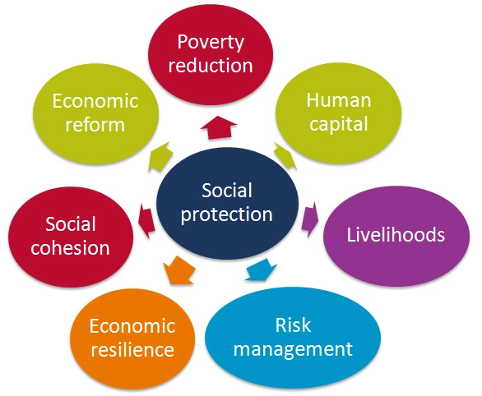
Social protection is concerned with preventing, managing, and overcoming situations that adversely affect people’s well-being.
ILO
Social protection is a set of policies and programmes designed to reduce and prevent poverty and vulnerability throughout the lifecycle
World Bank
Social protection systems help individuals and families, especially the poor and vulnerable, cope with crises and shocks, find jobs, improve productivity, invest in the health and education of their children, and protect the aging population.
ADB
Social protection is defined as the set of policies and programs designed to reduce poverty and vulnerability by promoting efficient labor markets, diminishing people’s exposure to risks, and enhancing their capacity to protect themselves against hazards and interruption/loss of income

Slide 3
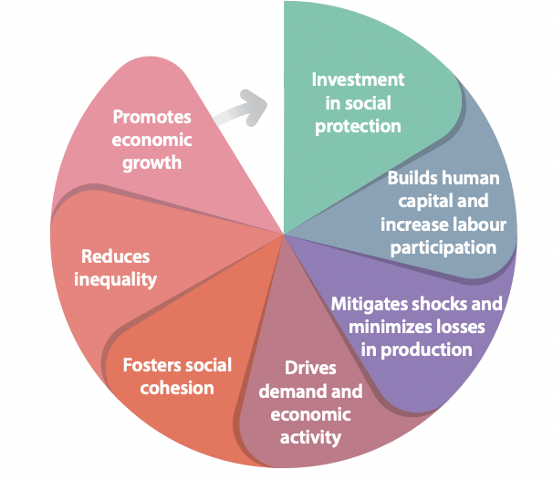
Why do we need Social Protection?
Social protection creates a virtuous cycle of economic growth while helping tackle risks faced by individuals, poverty and vulnerability, and inequality

Slide 4
Ensuring social security for is well-articulated in various human and UN legal instruments as well as Sustainable Development Goals.
The Universal Declaration of Human Rights (UDHR)
Art 22 - “Everyone, as a member of society, has the right to social security and is entitled to realisation, through national effort and international cooperation and in accordance with the organisation and resources of each state, of the economic, social and cultural rights indispensable for his dignity and the free development of his personality”
Art 23(1) – “Everyone has the right to a standard of living adequate for the health and well-being of himself and of his family, including food, clothing, housing and medical care and necessary social services, and the right to security in the event of unemployment, sickness, invalidity, widowhood, old age or other lack of livelihood in circumstances beyond his control”.
The International Covenant on Economic, Social and Cultural Rights (ICESCR)
Art 9 – “[t]he States Parties to the present Covenant recognise the right of everyone to social security, including social insurance”
The Convention on the Elimination of All Forms of Discrimination Against Women, 1979 (Art 11(1)(e), 11(2)(b), & 14(2)); the Convention on the Elimination of All Forms of Racial Discrimination, 1965 (Art 5(e)(iv)); the Convention on the Rights of the Child, 1989 (Art 26, 27(1), 27(2), & 27(3)); International Convention on the Protection of the Rights of All Migrant Workers and Their Families, 1990 (Art 27 & 54); the Convention on the Rights of Persons with Disabilities, 2006 (Art 28)
Preamble of ILO constitution—to improve the conditions of labours through, among others, “the prevention of unemployment, …. The protection of the worker against sickness, disease, and injury arising out of his employment, the protection of children, young persons and women, provision for old age and injury”
Adopted a total of 31 conventions (binding instruments) over the years to implement its core mandates
Specifically, the landmark convention – the Social Security (Minimum Standards) Convention, 1952 (No. 102), a globally recognised key reference for the design of rights-based, sound and sustainable social protection schemes and systems
Global consensus that ‘Social security is a basic social right to which every human being is entitled’
Right to social security in various UN legal instruments
SDG 1.3: Implement nationally appropriate social protection Systems and measures for all, including floors, and by 2030 achieve substantial coverage of the poor and the vulnerable
The core issue of the ILO’s mandate – ‘Social security for all’
Importance of social security also envisioned in the SDGs

Slide 5
Social protection staircase
ILO’s Social Protection Floors

Slide 6
Lifecycle risks
Source: Hasan (2020)

Slide 7
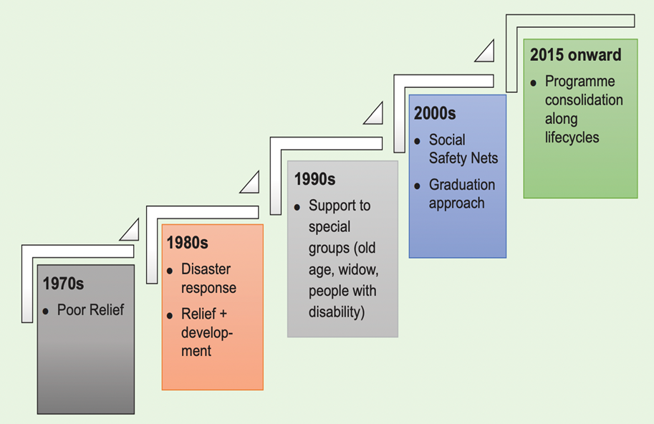
Evolution of SP in Bangladesh
1970s - the focus of social security programmes was relief work and vulnerable group feeding.
1980s - mainly disaster response and relief operation.
1990s, programmes were taken to provide support to special groups like elderly, widows and people with disability. These programmes were often supported by the development partners and NGOs. The provision of cash transfer was widely introduced in these programmes.
2000s - numerous social safety net programmes to support different types of risks and vulnerabilities. These safety net programmes were often reinforced with graduation programmes to bring the poor sustainably out of poverty.
2015- Bangladesh adopted lifecycle based strategic and comprehensive approach to social protection

Slide 8
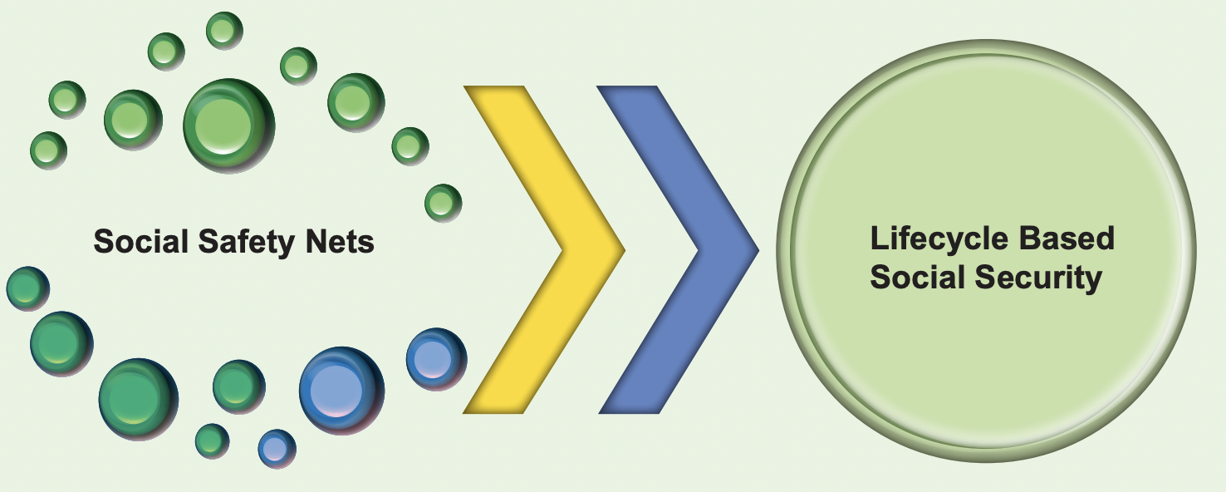
National Social Security Strategy (NSSS), 2015
Paradigm shift: from ad hoc social safety nets to lifecycle based social security
Source: Hasan (2020)

Slide 9
NSSS 2015: Core lifecycle programmes

Slide 10
Group Exercise
Identify the schemes that can be considered as compatible with the lifecycle approach to social protection.

Slide 11
Trends in social protection spending in Bangladesh

Slide 12
Social protection spending: Too thinly spread over too many programmes

Slide 13
Old age allowance: Comprehensive to universal
Current status (comprehensive)
Total beneficiaries: 57.01 lacs
Total budget: BDT 3444.54 crore
Towards a universal system
Estimated total beneficiaries: 100.74 lacs
Estimated total budget: BDT 6044.4 crore
Beneficiary calculation
Total population: 167.9 million
Old aged population: 6% of total population
Total no. of beneficiaries: 167.9*0.06=10.074 million = 100.74 lacs
Total budget=500*100.74*12=6044.4 crore TK
➔No inflation adjustments
➔Tk 500 is grossly inadequate

Slide 14
Policy discussion
As countries become richer, they need to spend less on social protection. And countries cannot afford higher spending on social protection.
Please list a maximum of 5 important points (for or against or neutral)

Slide 15
Social spending in OECD countries – avg. 20% of GDP.

Slide 16
Different types of social protection
Social Protection
Social Insurance
Social Assistance
Active Labour Market Policies
Based on Contribution (solidarity) by Government, Employers, Workers, other stakeholders
Non-contributory - based on Government budget allocation
Supported by Government through relevant institutions
Examples: Employment Injury Protection; Unemployment Insurance; Maternity Protection, Old-age Pension, etc
Examples: social pension, food assistance, access to free health, disaster relief, etc
Examples:
Wages, Job protection,
Skills Development, Livelihoods, Enterprise development, etc

Slide 17
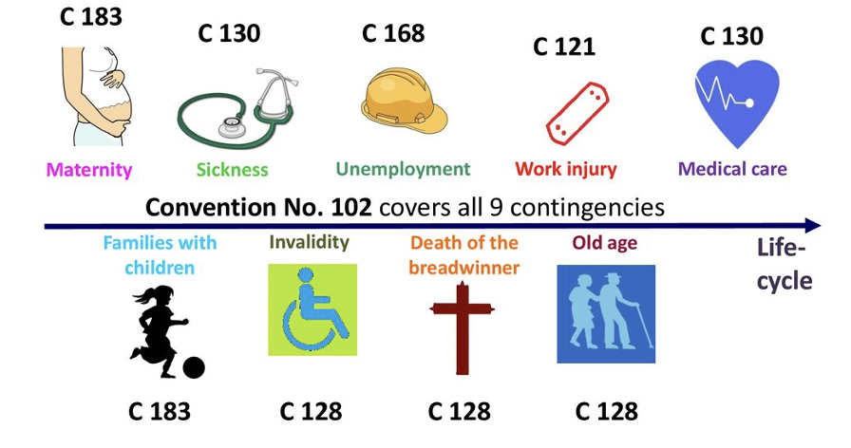
ILO Social Security Standards to realise the rights to social security

Slide 18
The National Social Security Strategy, adopted in 2015, called for establishing a National Social Insurance Scheme (NSIS)
The NSSS stipulates
Support for every stage of life
Special focus on vulnerable groups
The NSSS envisioned establishing a (NSIS)
As the Govt’s long-term vision for social security to deal with demographic transition.

Slide 19
NSIS and It’s components
NSIS will help fill one gap in the lifecycle-base social protection framework
The NSIS will be based on joint contributions from employers and employees
Initially, it will be targeted to formal sector employees
To start with, the NSIS will be managed by the Ministry of Finance
To be regulated under the Insurance Act, 2010
The responsibility of preparing the NSIS was given to the Ministry of Labour & Employment
The Cabinet will agree the specific design of the NSIS based on the recommendations received
i.e. to address the lack of support for the working age population group

Slide 20
A form of social security designed to protect income-earners and their families against a reduction or loss of income as well as guard them from falling into vulnerabilities and poverty in the events of exposure to risks i.e., health risks, accidents, unemployment, old age etc. Principle: solidarity and risk-pooling
Social Insurance: International Standards and global best practices
Two fundamental ILO Convention and Recommendation on social insurance:
C 102: Social Security (Minimum Standards) Convention, 1952
R 202: Social Protection Floors Recommendation, 2012
NSIS
Unemployment
Injury
C 121: Employment Injury Benefits, 1964
Maternity
Sickness
R 121: Employment Injury Benefits, 1964
C 183: Maternity Protection Convention, 2000
C 168: Employment Promotion and Protection against Unemployment Convention, 1988
R 176:Employment Promotion and Protection against Unemployment Recommendation, 1988
C 130: Medical Care and Sickness Benefits, 1969
R 134: Medical Care and Sickness Benefits, 1969
R 191: Maternity Protection Recommendation, 2000

Slide 21
Group Exercise
Designing an Unemployment Insurance Scheme for the RMG Sector
Required Assumptions
Coverage: only RMG sector workers
Total number of RMG sector workers: 40 lacs
Estimated average monthly wage – BDT 13,000
Unemployment rate – 5%
Contribution mechanism – joint contributory scheme by employers and workers sharing the cost equally
Benefit rate – 50 per cent of the average monthly wage
Maximum benefit duration – 3 months
Administrative and operational expenses – entirely borne by government

Slide 22
Major programmatic reforms introduced by NSSS 2015
1. Strengthening social security for Children (age 1<18)
Child benefit
Primary and secondary school stipends
Continuing orphans and school meals programme
Ensuring child maintenance payment for abandoned children
Strengthen immunisation, child healthcare, nutrition and water and sanitation programmes
2. (a) Strengthening programmes for working age (age 19-59)
Strengthen education and training
Strengthen workfare programmes
Introducing unemployment, accident, sickness and maternity insurance under NSIS
2. (b) Strengthening programmes for vulnerable women (age 19-59)
Consolidate into one Vulnerable Women Benefit programme on a cash basis
Provision of childcare across all formal & informal employment
Maternal healthcare
Training programmes
3. Comprehensive pension system for elderly
Old age allowance (age 60+)
Government service pension
Private voluntary pensions
4. Strengthening the system of social security for people with disabilities
A disability benefit for working age population with disabilities
A disability benefit for children with disabilities
5. Strengthening the social security system for the urban poor
6. Consolidate and reform food security type programmes
7. Consolidate small, special and covariate risk mitigation programmes

Slide 23
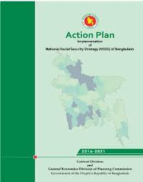
Stocktaking the Progress Made on Programmatic Reforms

Slide 24
A Summary of Performance: Programmatic Reforms
Low
High
Low
High
Low
High
Programmes for Children
Education & Training
Pension for Elderly
Low
High
Programmes for People with disabilities
Low
High
Low
High
Low
High
Programme for Urban Poor
Reform Food Security
Programmes
Programme Consolidation

Slide 25
Programmatic Reforms: Off-track/On-track Indicators

Slide 26
Institutional reforms as per the National Social Security Strategy, 2015

Slide 27
High targeting errors in social protection coverage
(Estimated from the HIES 2016)

Slide 28
Summary findings from Midterm Progress Review on institutional reforms
Low
High
Low
High
Low
High
CMC Cluster
Single Registry MIS
G2P
Low
High
Low
High
Low
High
Strengthening selection processes
Grievance Redress System
M&E

Slide 29
Findings from Midterm Progress Review: Off-track/On-track Indicators as set out in the Nation Action Plan Phase-I (2016-2021)

Slide 30
Inadequate and weak institutional capacities
Administrative capacity
Lack of institutional capacities for collecting, analysing, and disseminating data
Lack of digitised and employment database – a major challenge for UI
Lack of robust monitoring mechanism to oversee the execution of the Labour Act
Social insurance deals with a complex employer and employee relationship. Lack of capacity to facilitate the consultation process.
Lack of well-designed institutional framework for ALMPs

Slide 31
Policy discussion
Targeting errors can be eliminated by tackling malpractices of the officials involved in the selection of beneficiaries.

Slide 32
Thank You!

